Slide 1

Chapter 25 Introduction to Database Security Part 1

Slide 2
Chapter Outline
Introduction to Database Security Issues
Discretionary Access Control Based on Granting Revoking Privileges
Mandatory Access Control and Role-Based Access Control for Multilevel Security
SQL Injection
Introduction to Statistical Database Security
Introduction to Flow Control
Encryption and Public Key Infrastructures
Privacy Issues and Preservation
Challenges of Database Security
Oracle Label-Based Security

Slide 3
Database Security Issues
Legal and ethical issues
The right to access certain information
Policy issues
At govermental, institutional, or corporate level as to what kinds of information should not be made publicly available
System-related issues
Which various security functions should be enforced on systems

Slide 4

Threats and Countermeasures
Threats to Databases
Loss of integrity
Unauthorized changes made to the data by intentional or accidental acts
Loss of availability
Data unavailable to users to which they have a legitimate right
Loss of confidentiality
Refer to the protection of data from unauthorized disclosure
Four kinds of countermeasures
access control
inference control
flow control
encryption
Data

Slide 5
Control Measures
Access Control
restricting access to the database
handled by using accounts and passwords to control login process by the DBMS
Inference Control
To prevent from deducing certain facts concerning individuals from queries that involve only summary statistics on groups (or from statistical databases)
Statistical database
used to provide statistical information or summaries of values based on various criteria.
Select max(salary) from Emp
Data
CEO’s salary?

Slide 6


Control Measures
Flow Control
To prevents information from flowing in such a way that it reaches unauthorized users.
Channels that are pathways for information to flow implicitly in ways that violate the security policy of an organization are called covert channels.
Data Encryption
used to protect sensitive data (such as credit card numbers) that is being transmitted via some type communication network
The data is encoded using some coding algorithm. An unauthorized user who access encoded data will have difficulty deciphering it, but authorized users are given decoding or decrypting algorithms (or keys) to decipher data.
Encrypted Data
A
Flow
B
X?%^*&%)I,gS#!@ ...
decrypt
The account and password are …
email
key
Class S
Class U

Slide 7

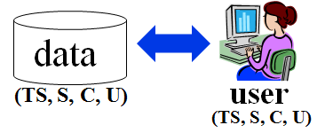
Database Security Mechanisms
A DBMS typically includes a database security and authorization subsystem responsible for ensuring the security portions of a database against unauthorized access.
Two types of database security mechanisms:
Discretionary security mechanisms
To grant privileges to users, e.g. the capability to access specific data
Mandatory security mechanisms
To enforce multilevel security by classifying the data and users into various security classes

Slide 8
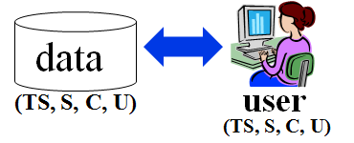
1.2 Database Security and the DBA
The DBA is responsible for the overall security of the database system.
1. Account creation
2. Privilege granting
3. Privilege revocation
4. Security level assignment
Action 1 is access control, whereas 2 and 3 are discretionary and 4 is used to control mandatory authorization.
DBA
Select? Insert?
Delete? Drop?

Slide 9
Database Audits
DBMS must keep track of all operations that are applied by a certain user throughout each login session.
To keep a record of all updates applied to the database and of the particular user who applied each update, we can modify system log, which includes an entry for each operation applied to the database that may be required for recovery from a transaction failure or system crash.
Database Audit
reviewing the log to examine all accesses and operations applied to the database during a certain time period.
Audit Trail
A database log that is used mainly for security purposes
…
…
…
…
200. 15:30:20 leeys inserts employee …
201. 15:32:30 leeys deletes project …
…
System log

Slide 10
Chapter Outline
Introduction to Database Security Issues
Discretionary Access Control Based on Granting Revoking Privileges
Mandatory Access Control and Role-Based Access Control for Multilevel Security
SQL Injection
Introduction to Statistical Database Security
Introduction to Flow Control
Encryption and Public Key Infrastructures
Privacy Issues and Preservation
Challenges of Database Security
Oracle Label-Based Security

Slide 11
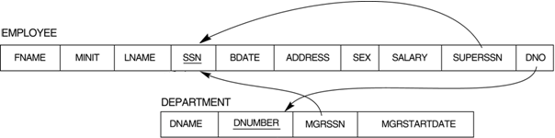
Discretionary Access Control Based on Granting and Revoking Privileges
Enforcing discretionary access control is based on the granting and revoking privileges.
Types of Discretionary Privileges
The account level
specifies the particular privileges that each account holds independently of the relations.
The relation (or table) level
control the privilege to access each individual relation or view.
account level
relation level
(select? update? …)
(select? update? …)

Slide 12
Privileges at Account Level
The privileges at the account level can include
the CREATE SCHEMA or CREATE TABLE privilege, to create a schema or base relation;
schema屬於架構,database(Ex,company )，table屬於表單
The CREATE VIEW privilege;
the ALTER privilege, to apply schema changes such adding or removing attributes from relations; 修改table的權利
the DROP privilege, to delete relations or views; 刪除資料表
the MODIFY privilege, to insert, delete, or update tuples;
the SELECT privilege, to retrieve information from the database by using a SELECT query.
Create? Select? Update? …
DB
account level

Slide 13
Discretionary Privileges at Relation Level
The second level of privileges applies to the relation level, whether they are base relations or virtual (view) relations.
Access matrix model, where the rows of a matrix M represents subjects (users, accounts, programs) and the columns represent objects (relations, records, columns, views, operations).
Each position M(i,j) in the matrix represents the types of privileges (read, write, update) that subject i holds on object j.
 | Employee | Project.PName | … | …
User1 | read | update | … | …
User2 | read | update | … | …
Program1 | update | write | … | …
… | … | … | … | …
Access Matrix

Slide 14
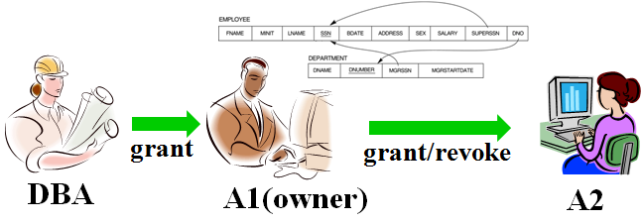
Discretionary Privileges: Grant and Revoke
Each relation R is assigned an owner account, which is typically the account that was used when the relation was created.
The owner is given all privileges on that relation.
In SQL2, the DBA can assign an owner to a whole schema by creating the schema and associating the appropriate authorization identifier with that schema, using CREATE SCHEMA.
The owner account holder can pass privileges on any of the owned relation to other users by granting privileges to their accounts.

Slide 15
An Example
Suppose that the DBA creates four accounts --A1, A2, A3, and A4-- and wants only A1 to be able to create base relations; then the DBA must issue the following GRANT command in SQL:
GRANT CREATETAB TO A1;
In SQL2 the same effect can be accomplished by having the DBA issue a CREATE SCHEMA command as follows:
CREATE SCHEMA COMPANY AUTHORIZATION A1;
User account A1 can create tables under the schema called COMPANY.
grant
grant/revoke
DBA
A1(owner)
A2

Slide 16
Privileges in SQL on Relation R
SELECT (retrieval or read) privilege on R
gives the account the privilege to use the SELECT statement to retrieve tuples from R.
MODIFY privileges on R
In SQL this privilege is further divided into UPDATE, DELETE, and INSERT privileges to apply the corresponding SQL command to R.
In addition, both the INSERT and UPDATE privileges can specify that only certain attributes can be updated by the account.
REFERENCES privilege on R
gives the account the capability to reference relation R when specifying integrity constraints.
The privilege can also be restricted to specific attributes of R.
R

Slide 17
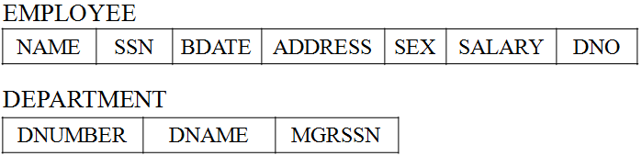
An Example (2)
A1 creates the two base relations EMPLOYEE and DEPARTMENT;
A1 is then owner and hence all the relation privileges on each of them.
A1 wants to grant A2 the privilege to insert and delete tuples in both of these relations:
GRANT INSERT, DELETE ON EMPLOYEE, DEPARTMENT TO A2;
grant
INSERT DELETE
A1: owner
A2

Slide 18
Revoking Privileges
REVOKE command is for the purpose of canceling privileges.
REVOKE SELECT ON EMPLOYEE FROM A2;
REVOKE
SELECT
A1: owner
A2

Slide 19
Propagation of Privileges using the GRANT OPTION
Whenever the owner A of a relation R grants a privilege on R to another account B, privilege can be given to B with or without the GRANT OPTION.
If the GRANT OPTION is given, this means that B can also grant that privilege on R to other accounts
In this way, privileges on R can propagate to other accounts without the knowledge of the owner of R.
If the owner account A now revokes the privilege granted to B, all the privileges that B propagated based on that privilege should automatically be revoked by the system.
A
B
C
grant
grant
with GRANT option

Slide 20
An Example (3)
A1 wants to allow A3 to retrieve information from either of the two tables and also to be able to propagate the SELECT privilege to other accounts.
A1 can issue the command:
GRANT SELECT ON EMPLOYEE, DEPARTMENT TO A3 WITH GRANT OPTION;
A3 can grant the SELECT privilege on the EMPLOYEE relation to A4 by issuing:
GRANT SELECT ON EMPLOYEE TO A4;
A1 decides to revoke the SELECT privilege on the EMPLOYEE relation from A3; A1 can issue:
REVOKE SELECT ON EMPLOYEE FROM A3;
The DBMS must automatically revoke the SELECT privilege on EMPLOYEE from A4, because A3 granted that privilege to A4 and A3 does not have the privilege any more.
A1
A3
A4
grant
grant
with GRANT option

Slide 21
2.2 Specifying Privileges Using Views
To create a view, the account must have SELECT privilege on all relations involved in the view definition.
The mechanism of views is an important discretionary authorization mechanism in its own right.
If the owner A of a relation R wants another account B to be able to retrieve only some fields, then A can create a view V that includes only those attributes and then grant SELECT on V to B.
The same applies to limiting B to retrieving only certain tuples; a view V’ can be created by defining the view by means of a query that selects only those tuples that A wants to allow B to access.
R
V
user B
owner A

Slide 22
An Example(4)
A1 wants to give back to A3 a limited capability to SELECT from the EMPLOYEE relation and wants to allow A3 to be able to propagate the privilege.
The limitation is to retrieve only the NAME, BDATE, and ADDRESS attributes and only for the tuples with DNO=5.
A1 then create the view:
CREATE VIEW A3EMPLOYEE AS
SELECT NAME, BDATE, ADDRESS
FROM EMPLOYEE
WHERE DNO = 5;
A1 can grant SELECT on the view A3EMPLOYEE to A3:
GRANT SELECT ON A3EMPLOYEE TO A3 WITH GRANT OPTION;
EMP
A3EMP
A1
A3
A3
grant on
view
owner A1

Slide 23
An Example (5)
Suppose that A1 wants to allow A4 to update only the SALARY attribute of EMPLOYEE;
A1 can issue:
GRANT UPDATE ON EMPLOYEE (SALARY) TO A4;
The UPDATE or INSERT privilege can specify particular attributes that may be updated or inserted in a relation.
Other privileges (SELECT, DELETE) are not attribute specific.
GRANT
update on
EMPLOYEE(SALARY)
A1
A4

Slide 24
2.6 Specifying Limits on Propagation of Privileges
Techniques to limit the propagation of privileges have been developed, although they have not yet been implemented in most DBMSs and are not a part of SQL.
Limiting horizontal propagation to an integer number i means that an account B given the GRANT OPTION can grant the privilege to at most i other accounts.
Vertical propagation is more complicated; it limits the depth of the granting of privileges.
R
R
user B
i
i-1
B
C
…
… …
≤ i
owner A
owner A
user X

Slide 25
Chapter Outline
Introduction to Database Security Issues
Discretionary Access Control Based on Granting Revoking Privileges
Mandatory Access Control and Role-Based Access Control for Multilevel Security
SQL Injection
Introduction to Statistical Database Security
Introduction to Flow Control
Encryption and Public Key Infrastructures
Privacy Issues and Preservation
Challenges of Database Security
Oracle Label-Based Security

Slide 26
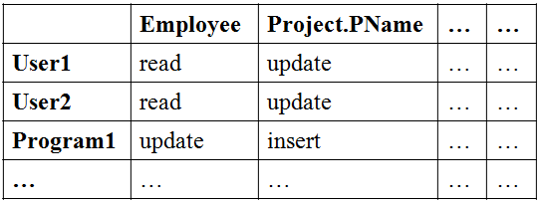
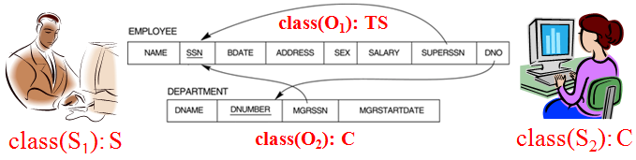
3 Mandatory Access Control and Role-Based Access Control for Multilevel Security
The discretionary access control is an all-or-nothing method.
A user either has or does not have a certain privilege.
In many applications, and additional security policy is needed that classifies data and users based on security classes. This approach as mandatory access control, would typically be combined with the discretionary access control mechanisms.
Discretionary Access Control
Mandatory Access Control

Slide 27
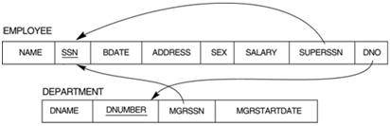
Multilevel Security: Bell-LaPadula Model
Typical security classes are
top secret (TS), secret (S), confidential (C), and unclassified (U), where TS is the highest level and U the lowest: TS ≥ S ≥ C ≥ U
Bell-LaPadula model
classifies each subject (user, account, program) and object (relation, tuple, column, view, operation) into one of the security classifications, T, S, C, or U.
A subject S is not allowed read access to an object O unless class(S) ≥ class(O). This is known as the simple security property.
A subject S is not allowed to write an object O unless class(S) ≤ class(O). This known as the star property (or * property).
class(O1): TS
class(S1): S
class(O2): C
class(S2): C

Slide 28
Multilevel Security for A Relation
Each attribute A is associated with a classification attribute C.
In some models, a tuple classification attribute TC is added.
The value of the TC attribute in each tuple t – which is the highest of all attribute classification values within t – provides a general classification for the tuple itself.
A multilevel relation schema R
R(A₁, C₁, A₂, C₂, …, A_{n}, C_{n}, TC)
where each C_{i} represents the classification attribute associated with attribute A_{i}.
The apparent key of a multilevel relation is the set of attributes that would have formed the primary key in a regular (single-level) relation.
Name | Salary | JobPerformance | TC
Smith U | 40000 C | Fair S | S
Brown C | 80000 S | Good C | S

Slide 29
Filtering
A multilevel relation will appear to contain different data to subjects (users) with different clearance levels.
It is possible to store a single tuple at a higher classification level and produce the corresponding tuples at a lower-level classification through a process known as filtering.
The original EMPLOYEE tuples
Name | Salary | JobPerformance | TC
Smith U | 40000 C | Fair S | S
Brown C | 80000 S | Good C | S
Classification C users see
Classification U users see
Name | Salary | JobPerformance | TC
Smith U | 40000 C | NULL C | C
Brown C | NULL C | Good C | C
Name | Salary | JobPerformance | TC
Smith U | NULL U | NULL U | U

Slide 30
Polyinstantiation
Sometimes, it is necessary to store two or more tuples at different classification levels with the same value for the apparent key.
This leads to the concept of polyinstantiation where several tuples can have the same apparent key value but have different attribute values for users at different classification levels.
The original EMPLOYEE tuples
Name | Salary | JobPerformance | TC
Smith U | 40000 C | Fair S | S
Brown C | 80000 S | Good C | S
Name | Salary | JobPerformance | TC
Smith U | 40000 C | Fair S | S
Smith U | 40000 C | Excellent C | C
Brown C | 80000 S | Good C | S
Polyinstantiation of the Smith tuple

Slide 31
Entity Integrity Constraint in Multilevel Relation
The entity integrity rule for multilevel relations states that
1. All attributes that are members of the apparent key must not be null and must have the same security classification within each individual tuple.
2. All other attribute values in the tuple must have a security classification greater than or equal to that of the apparent key.
R(A1, C1, A2, C2, A3, C3, …, An, Cn, TC)
where C1 = C2 ≤ Ci, 3 ≤ i ≤ n

Slide 32
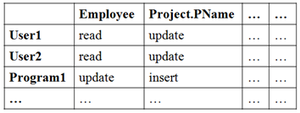
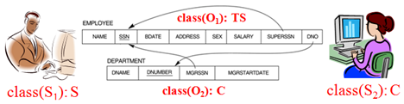
3.1 Comparing Discretionary Access Control and Mandatory Access Control
Discretionary Access Control (DAC) policies
Advantage: high degree of flexibility, which makes them suitable for a large variety of application domains.
Disadvantage: their vulnerability to malicious attacks, such as Trojan horses embedded in application programs.
Mandatory Access Control (MAC) policies
Advantage: high degree of protection, which prevents any illegal flow of information.
Disadvantage: being too rigid; only applicable in limited environments.
In many practical situations, discretionary policies are preferred because they offer a better trade-off between security and applicability.

Slide 33
3.2 Role-Based Access Control
Role-based access control (RBAC) emerged rapidly in the 1990s as a proven technology for managing and enforcing security in large-scale enterprisewide systems.
Privileges are associated with roles, and users are assigned to appropriate roles,
such as sales account, manager, purchasing agent, department manager, and so on.
Roles can be created using the CREATE ROLE and DESTROY ROLE commands.
The GRANT and REVOKE commands can then be used to assign and revoke privileges from roles.
CREATE ROLE manager;
GRANT ROLE manager TO hsucc;
GRANT ROLE sales-account TO leeys;
Privileges
ROLE
ACCOUNT

Slide 34
Role Hierarchy
Role hierarchy is a natural way of organizing roles to reflect the organization’s lines of authority and responsibility.
If a user has one role, the user automatically has roles lower in the hierarchy.
executive
data
manager
hsucc:
manager
employee
Role Hierarchy

Slide 35
Temporal Constraints and Web-base AP
Another important consideration in RBAC is the possible temporal constraints that may exist on roles, such as
time and duration of role activations, and
timed triggering of a role by an activation of another role.
Using an RBAC model is highly desirable goal for addressing the key security requirements of Web-based applications.
Discretionary access control (DAC) and mandatory access control (MAC) models lack capabilities needed to support the security requirements of emerging enterprises and Web-based applications.
data
hsucc:
manager
(2010/1/1~2012/12/31)

Slide 36
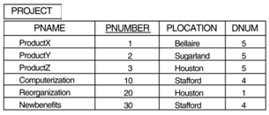

Label-Based Security and Row-Level Access Control
Row-level access control
Access control can be implemented by considering the data row by row.
Each data row is given a label, storing information about data sensitivity.
A user having a low authorization level is denied access to data having a higher-level number.
Suppose a user has SELECT privileges. If the user has a sensitivity of 20, then the user can view all rows having a security level of 20 or lower.
Level: 20

Slide 37
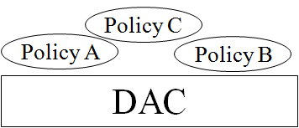
Label-Based Security
A policy defined by an administrator is called a Label Security policy.
When a policy is implemented, a new column is added to each row. The added column contains the label for each row that reflects the sensitivity of the row.
The Label Security requirements are applied on top of the DAC requirements.
The user must satisfy the DAC requirements and then the label security requirements to access a row.
Levels
A B C

Slide 38
3.3 Access Control Policies for E-Commerce and the Web
E-Commerce environments require elaborate policies that go beyond traditional DBMSs.
The resources to be protected are not only traditional data but also knowledge and experience.
The access control mechanism should be flexible enough to support a wide spectrum of heterogeneous protection objects.
data
knowledge
experience
Various types of objects to be protected
(heterogeneous objects)

Slide 39

Access Control Policies for E-Commerce and the Web
Another requirement is related to the heterogeneity of subjects, which requires access control policies based on user characteristics and qualifications.
A credential is a set of properties concerning a user that are relevant for security purposes (e.g., age, position, or role within an organization).
By using credentials, one can formulate policies such as
Policy A: Only permanent staff with five or more years of service can access documents related to the internals of the system.
60
CEO
manager
Heterogeneous subjects
65
teacher
customer

Slide 40
Frequent Attacks on Databases
SQL Injection
Unauthorized Privilege Escalation
An individual attempting to elevate his privilege by attacking vulnerable points in DBMS
Denial of Service (DOS) Attack
To make resources unavailable to its intended users by overflowing the buffer or consuming resources
Weak Authentication
If the user authentication scheme is weak, an attacker can impersonate the identity of a legitimate user by obtaining their login credentials
Passwords:
abcde, 12345678, tel#, birthdate, qwerty, …
Zombies
Server
Attacker

Slide 41
SQL Injection Methods
Attacker injects a string input thru the application, which changes or manipulate the SQL statement to the attacker’s advantage.
SQL Manipulation
Code Injection
Function Call Injection

Slide 42
SQL Manipulation
A manipulation attack changes an SQL command in the application
SELECT *
FROM users
WHERE username = ‘jake’ and PASSWORD = ‘jakepasswd’
The attacker can use the following:
SELECT *
FROM users
WHERE username = ‘jake’ and PASSWORD = ‘jakepasswd’ or ‘x’ = ‘x’

Slide 43
Code Injection
Code injection attack attempts to add additional SQL statements or commands to the existing SQL statement by exploiting a computer bug, which is caused by processing invalid data.
Code injection is a popular technique for system hacking or cracking to gain information.
statement = "SELECT * FROM users WHERE name = ' "+ userName +" ';"
The hacker input the following for the variable userName:
a';DROP TABLE users; SELECT * FROM userinfo WHERE 't' = 't
The SQL statement becomes:
SELECT * FROM users WHERE name = 'a';DROP TABLE users; SELECT * FROM userinfo WHERE 't' = 't';

Slide 44
Code Injection
statement = "SELECT * FROM users WHERE name = ' "+ userName +" ';"
If string userName is:
' or '1' = '1
SELECT * FROM users WHERE name = ' ' OR '1' = '1';
If string userName is:
' or '1' = '1' /* '
SELECT * FROM users WHERE name = ' ' OR '1' = '1' /* ';

Slide 45
Function Call Injection
A database function or operating system function call is inserted into a vulnerable SQL statement to manipulate the data or make a privileged system call
The dual table is used in the FROM clause of SQL in Oracle when a user needs to run SQL that does not logically have a table name.
SELECT SYSDATE FROM dual;
SELECT TRANSLATE (‘user input’, ‘from_string’, ‘to_string’) FROM dual;
SELECT TRANSLATE (“||UTL_HTTP.REQUEST (‘http://129.107.2.1/’)||”, ‘98765432’, ‘9876’) FROM dual;

Slide 46
Function Call Injection
SELECT TRANSLATE (‘user input’, ‘from_string’, ‘to_string’) FROM dual;
TRANSLATE is used to replace a string of characters with another string of characters
This type of SQL statement is subjected to a function injection attack:
SELECT TRANSLATE (“||UTL_HTTP.REQUEST (‘http://129.107.2.1/’)||”, ‘98765432’, ‘9876’) FROM dual;
The attacker can retrieve useful information from the database server—located at the URL that is passed as a parameter—and send it to the Web server (that calls the TRANSLATE function).

Slide 47
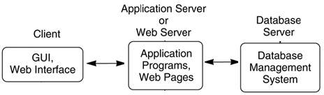
Risks Associated with SQL Injection (1)
Database Fingerprinting
Determine the type of database being used in the backend so that he can use database-specific attacks that correspond to weaknesses in a particular DMBS
Denial of Service (DOS)
Bypassing Authentication
Identifying Injectable Parameters
The attacker gathers information about the type and structure of the back-end DB of a Web application.
This attack is made possible by the fact that the default error page returned by application servers is often overly descriptive
PHP 2.0
MS SQL 2000

Slide 48
Risks Associated with SQL Injection (2)
Executing Remote Commands
This provide attackers with a tool to execute arbitrary commands on the DB.
Performing Privilege Escalation
This type of attack takes advantage of logical flaws within the DB to upgrade the access level.

Slide 49
Protection Techniques against SQL Injection
Bind Variables (Using Parameterized Statements)
PreparedStatement stmt = conn.prepareStatement(“SELECT * FROM EMPLOYEE WHERE EMPLOYEE_ID=? AND PASSWORD=?”);
stmt.setString(1, employee_id);
stmt.setString(2, password);
Filtering Input (Input Validation)
To remove escape characters from input strings by using the SQL Replace function, e.g., the single quote (‘) can be replaced by two single quotes (‘’).
Function Security
DB functions should be restricted, as they can be exploited in the SQL function injection attacks.
statement = "SELECT * FROM users WHERE name = ' "+ userName +" ';"
SELECT * FROM users WHERE name = 'a';DROP TABLE users; SELECT * FROM userinfo WHERE 't' = 't';

Slide 50
Filter Input (Input Validation)
Function mysql_real_escape_string(String) prepends backslashes (\) to the following characters in the String:
\x00, \n, \r, \, ', " and \x1a.
Example
$Username: ' or '1' = '1
mysql_real_escape_string($Username): \' or \'1\' = \'1
$query = sprintf("SELECT * FROM Users WHERE UserName='%s' AND Password='%s'",
mysql_real_escape_string($Username), mysql_real_escape_string($Password)); /* PHP function
mysql_query($query);

Slide 51
Chapter 25 Introduction to Database Security Part 2

Slide 52
Chapter Outline
Introduction to Database Security Issues
Discretionary Access Control Based on Granting Revoking Privileges
Mandatory Access Control and Role-Based Access Control for Multilevel Security
SQL Injection
Introduction to Statistical Database Security
Introduction to Flow Control
Encryption and Public Key Infrastructures
Privacy Issues and Preservation
Challenges of Database Security
Oracle Label-Based Security

Slide 53
Statistical Database Security
Statistical databases are used mainly to produce statistics on various populations.
A population is a set of tuples of a relation that satisfy some selection condition.
Users are permitted to retrieve statistical information on the populations, such as averages, sums, counts, maximums, minimums, and standard deviations.
Confidential data on individuals should be protected from user access.
selection
condition
statistical
function
census
data
Statistical
information
DNO = 5
population
Statistical Queries
Notes:
統計數據庫主要用於生成各種人口的統計數據。
群體是滿足某些選擇條件的一組關係元組。
允許用戶檢索總體的統計信息，例如平均值，總和，計數，最大值，最小值和標準偏差。
應保護個人機密數據不被用戶訪問。

Slide 54
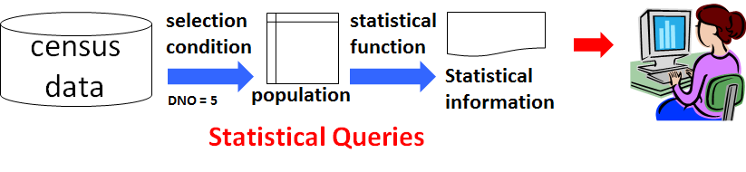
Statistical Queries
Statistical queries involve applying statistical functions to a population of tuples, such as
to retrieve the number of individuals in a population or the average income in the population.
not allowed to retrieve individual data, such as the income of a specific person.
Prohibit the retrieval of individual data.
by prohibiting queries that retrieve attribute values and
by allowing only queries that involve statistical aggregate functions such as COUNT, SUM, MIN, MAX, AVERAGE, and STANDARD DEVIATION.

Slide 55
Inferring Individual’s Information
It is possible to infer the values of individual tuples from a sequence statistical queries, especially when the conditions result in a population consisting of a small number of tuples.
Q1: SELECT COUNT(*) FROM PERSON WHERE <condition>;
Q2: SELECT AVG(Income) FROM PERSON WHERE <condition>
Interested in finding the Salary of Jane Smith, and we know her with
(Last_degree=‘Ph.D.’ AND Sex=‘F’ AND City=‘Bellaire’ AND State=‘Texas’)
If count ≤ 3, data can be easily inferred by using MIN, MAX, and AVG

Slide 56
Solutions to Information Inferring
No statistical queries are permitted whenever the number of tuples in the population specified by the selection condition falls below some threshold
To prohibit sequences of queries that refer repeatedly to the same population of tuples
To introduce slight inaccuracies or noise into the results of statistical queries deliberately
To partitioning of the database; Queries can refer to any complete group(s), but never to subsets of records within a group

Slide 57
Introduction to Flow Control
Flow control regulates the distribution or flow of information among accessible objects.
A flow between object X and object Y occurs when a program reads values from X and writes values into Y.
Flow controls check that information contained in some objects does not flow explicitly or implicitly into less protected objects.
A flow policy specifies the channels along which information is allowed to move.
The simplest flow policy specifies just two classes of information: confidential (C) and nonconfidential (N), and allows all flows except those from class C to class N.
X
program
Y
read
write
Class C
A flow
Class N
not allowed

Slide 58
Covert Channels
A covert channel allows information to pass from a higher classification level to a lower classification level through improper means.
One way to avoid covert channels is for programmers to not actually gain access to sensitive data that a program is supposed to process after the program has been put into operation.
X
Y
read
x
write
Class C
Class N
A covert channel
programmer
user

Slide 59
6 Encryption and Public Key Infrastructures
Encryption consists of applying an encryption algorithm to data using some prespecified encryption key.
The resulting data has to be decrypted using a decryption key to recover the original data.
The resulting data has to be cleaned …
encryption algorithm + encryption key
X?%^*&%)I,gS#!@ ...
decryption algorithm + decryption key
The resulting data has to be cleaned …

Slide 60
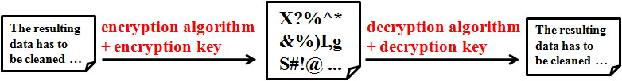
Data and Advanced Encryption Standards
Data Encryption Standard (DES)
a system developed by the U.S. government for use by the general public.
widely accepted as a cryptographic standard worldwide.
provide end-to-end encryption on the channel between the sender A and receiver B.
DES algorithm is a complex combination of two of the building blocks of encryption: substitution and permutation (transposition).
Its strength comes from repeated application of these two techniques for a total of 16 cycles.
Plaintext (the original form of the message) is encrypted as blocks of 64 bits.
After questioning the adequacy of DES, the National Institute of Standards (NIST) introduced the Advanced Encryption Standards (AES).
has a block size of 128 bits and thus takes longer time to crack.
A
B

Slide 61
Public Key Encryption
In 1976 Diffie and Hellman proposed public key encryption.
Public key algorithms are based on mathematical functions rather than operations on bit patterns.
Involve the use of two separate keys, in contrast to conventional encryption, which uses only one key.
The two keys used for public key encryption are referred to as the public key and the private key.
The public key is made for public.
The private key is kept secret by owner.
The resulting data has to be cleaned …
encryption algorithm + B’s public key
X?%^*&%)I,gS#!@ ...
decryption algorithm + B’s private key
The resulting data has to be cleaned …
A
B
A’s public key
A’s private key
B’s public key
B’s private key

Slide 62
Ingredients of Public Key Encryption
1. Plaintext : the data or readable message that is fed into the algorithm as input.
2. Encryption algorithm : The algorithm performs various transformations on the plaintext.
3. Public and private keys : pair of keys that have been selected so that if one is used for encryption, the other is used for decryption.
The exec transformations performed by the encryption algorithm depend on the public or private key that is provided as input.
4. Ciphertext : the scrambled message produced as output. It depends on the plaintext and the key.
For a given message, two different keys will produce two different ciphertexts.
5. Decryption algorithm : This algorithm accepts the ciphertext and the matching key and produces the original plaintext.
The resulting data has to be cleaned …
encryption algorithm + public key
X?%^*&%)I,gS#!@ ...
decryption algorithm + private key
The resulting data has to be cleaned …
Plaintext
Ciphertext
Plaintext

Slide 63
Public Key Encryption
The essential steps of a public key cryptographic algorithm:
Each user generates a pair of keys to be used for the encryption and decryption of messages.
Each user places one of the two keys in a public register or other accessible file. This is the public key. The companion key is kept private.
If a sender wishes to send a private message to a receiver, the sender encrypts the message using the receiver’s public key.
When the receiver receives the message, he or she decrypts it using the receiver’s private key. No other recipient can decrypt the message because only the receiver knows his or her private key.
The resulting data has to be cleaned …
encryption algorithm + B’s public key
X?%^*&%)I,gS#!@ ...
decryption algorithm + B’s private key
The resulting data has to be cleaned …
A
B
Receiver’s public key
Receiver’s private key

Slide 64
RSA Public Key Encryption
The RSA Public Key Encryption Algorithm
one of the first public key schemes was introduced in 1978 by Ron Rivest, Adi Shamir, and Len Adleman at MIT.
The RSA algorithm
incorporates results from number theory, combined with the difficulty of determining the prime factors of a target.
also operates with modular arithmetic – mod n.
n = a * b // a, b large prime number
P^{e} mod n // encrypt with e
(P^{e} )^{d} mod n = P // decrypt with d

Slide 65
RSA Public Key Encryption
Two keys, d and e, are used for decryption and encryption.
An important property is that d and e can be interchanged.
n is chosen as a large integer that is a product of two large distinct prime numbers, a and b. (i.e., n = a × b)
The encryption key e is a randomly chosen number between 1 and n that is relatively prime to (a-1) × (b-1).
The plaintext block P is encrypted as P^{e} mod n.
Because the exponentiation is performed mod n, factoring P^{e} to uncover the encrypted plaintext is difficult.
However, the decryption key d is carefully chosen so that (P^{e})^{d} mod n = P.
The decryption key d can be computed from the condition that d × e ≡ 1 (mod ((a-1) × (b-1))). (i.e., (d × e) mod ((a-1) × (b-1)) = 1)
Thus, the legitimate receiver who knows d simply computes (P^{e})^{d} mod n = P and recovers P without having to factor P^{e} .
The resulting data has to be cleaned …
P^{e} mod n
X?%^*&%)I,gS#!@ ...
(P^{e})^{d} mod n
The resulting data has to be cleaned …
key: e
key: d
P
C
P

Slide 66
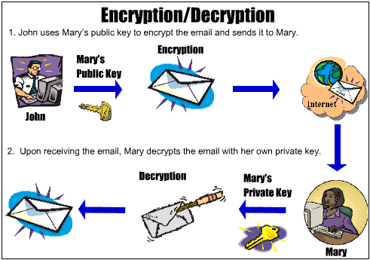
Encryption and Decryption

Slide 67
Digital Signatures
A digital signature is an example of using encryption techniques to provide authentication services in e-commerce applications.
A digital signature is a means of associating a mark unique to an individual with a body of text.
Other persons should be able to check that the signature does come from the originator.
A digital signature consists of a string of symbols.
Must be different for each use: achieved by making each digital signature a function of the message that it is signing, together with a time stamp.
To be unique to each signer and counterfeitproof: achieved by making each digital signature dependent on some secret number that is unique to the signer.
Public key techniques are the means creating digital signatures.
The resulting data has to be cleaned …
A secret number of
the signer
digital signature
The resulting data has to be cleaned …
+
A
B
(use A’s private key to sign)
(use A’s public key to verify)
time stamp

Slide 68
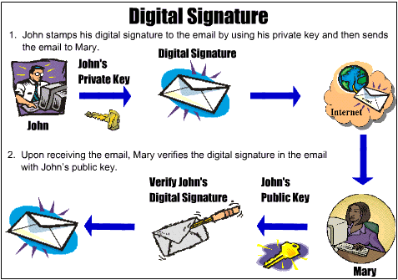
Digital Signatures

Slide 69
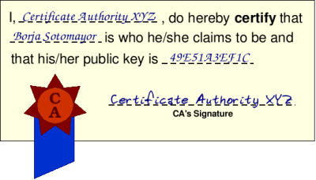


Digital Certificates
A digital certificate is used to combine the value of a public key with the identity of the person or service that holds the corresponding private key into a digitally signed statement.
Certificates are issued and signed by a certification authority (CA).
Digital Certificate
certification authority
Borja Sotomayor
his public key

Slide 70





Certificate owner: A
CA
A’s Private key
A’s Public key
sign
X?%^*&%)I,gS#!@ ...
B
Truly from A
verify

Slide 71
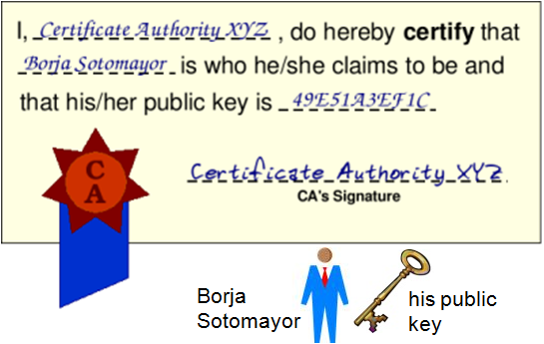
Digital Certificates
The information included in the certificate
The certificate owner information
The public key of the owner
The date of issue of the certificate
The validity period specified by ‘Valid From’ and ‘Valid To’
Issuer identifier
The digital signature of the issuing CA
All the information is encoded through a message-digest function, which creates the digital signature
The signature certifies that the association between the certificate owner and public key is valid.

Slide 72
Challenges of Database Security
Data Quality
Need techniques and solutions to assess the quality of data
Intellectual Property Rights
Watermarking techniques for relational data have been proposed.
Database Survivability
DB systems need to operate and continue their function, even with reduced capabilities, despite disruptive events such as information warfare attacks.
Confinement: to prevent damage further spread
Damage assessment
Reconfiguration: to allow operation to continue in a degraded mode
Repair
Fault treatment: to identify the weaknesses exploited in the attack

